Slide 1
Operational systems for conjunctive water management with MAR during droughts
Kick-off
11212698-002

Slide 2
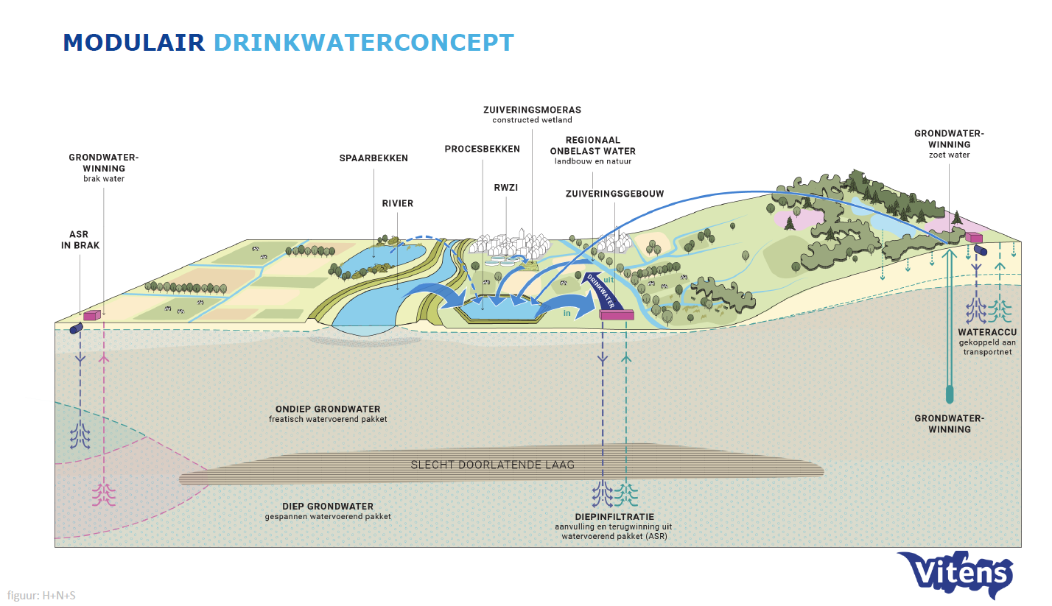
Conceptual model
Bron: Igor Jellema (visie Vitens; in ontwikkeling)

Slide 3
Optimization for reservoirs
Schematization (conceptual model):
Inequality constraints:
Groundwater volume physical range
minimum and maximum water level
pipeline capacity
Groundwater extraction
Objective function terms:
Groundwater level operational range and target
River intake limits
Minimize river intake from the river
Boundary conditions:
Natural groundwater recharge (source/sink)
Drinking water extraction (source/sink)
Groundwater (base) flow (Darcy leakage function)
Natural groundwater recharge
Drinking water extraction
Artificial recharge (river intake)
GW flow
Groundwater
reservoir
River-aquifer interaction
Equations (equality constraints):
$$\frac{∂V}{∂t}=Q_{\text{in}}−Q_{\text{out}}$$
$$V$$
$$t$$
$$Q$$
: Volume
: Time
: Discharge
This is a water balance model,
not a groundwater model!
Optimization task: Find out when to pump how much water from the river to ensure that the water extraction can be maintained.

Slide 4
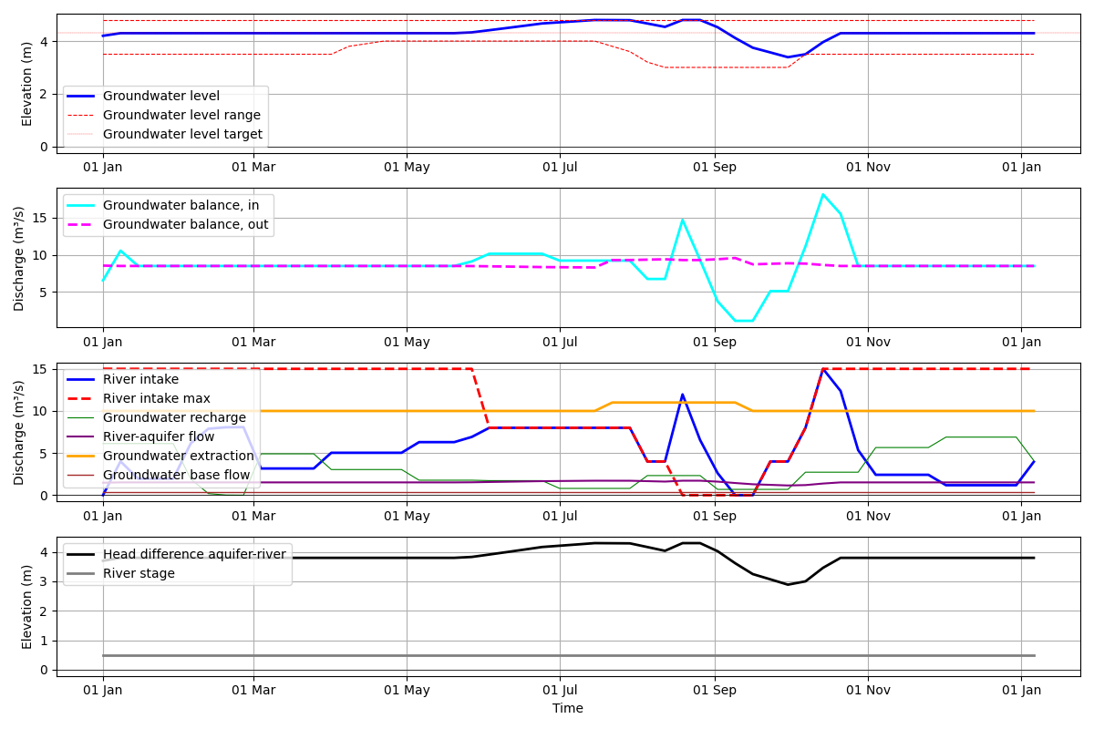
Priority on groundwater level
Groundwater operational range met
River intake macimum during the summer exceeded

Slide 5
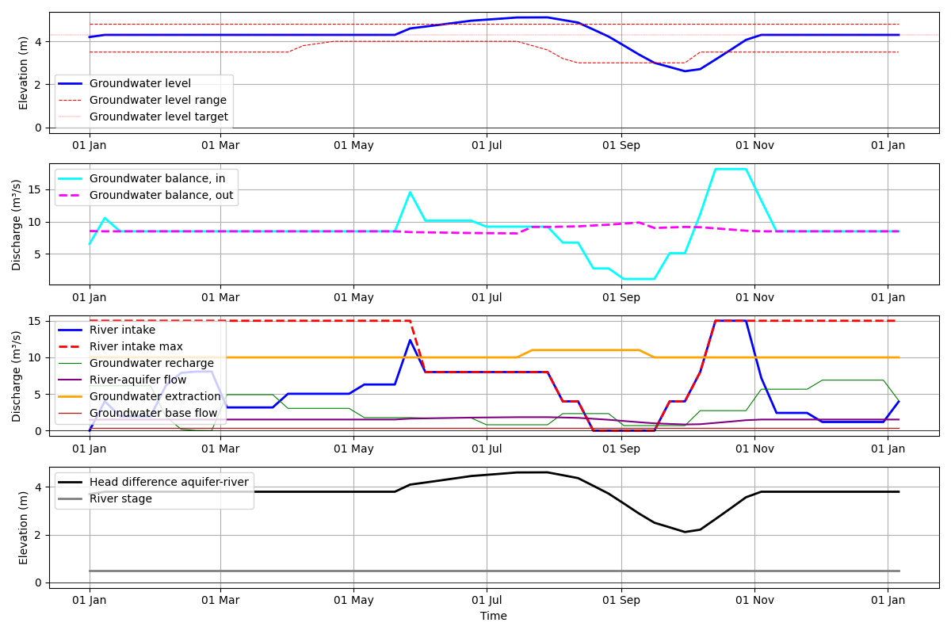
Priority on river intake
Groundwater operational range exceeded
River intake maximum during the summer obeyed
Less flow from aquifer to the river (base flow) during the summer

Slide 6
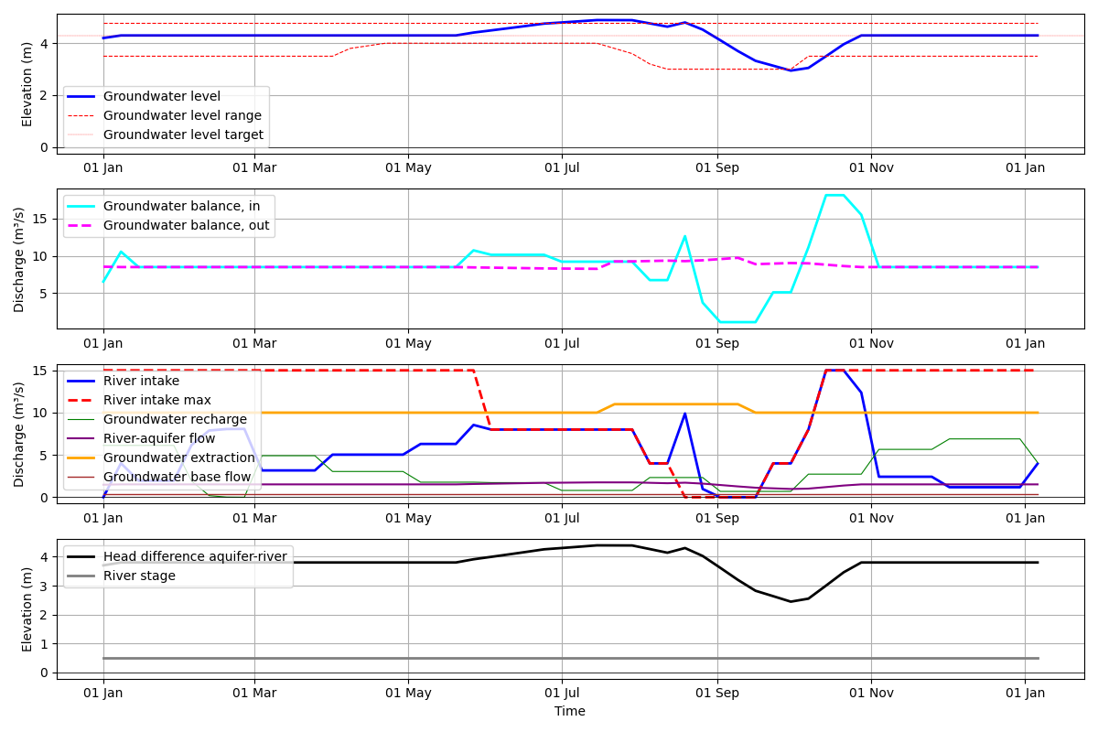
Compromised solution – same priority
Groundwater level and river intake goal are optimized together
same priority
Weighting factor
River inteake: 60%
Groundwater level range: 40%
Groundwater operational range exceeded
River intake maximum during the summer exceeded
Tuning the weighting factors is a bit tedious

Slide 7

Optimization model for groundwater reservoirs
Water balance model
no groundwater flow modelled
Darcy equation for river-aquifer interaction
Mathematical optimization
Comes with mathematical restrictions (linear equations)
fast solution, global optimum
Conflict resolution between use functions
Goal programming with priorities (multiple optimizations in a sequence)
Weighting factors for compromised solutions
Software: RTC-Tools (real-time-control tools)
Used for pump operations, hydropower scheduling and reservoir operation (“stuwmeren”)
Open Source, developed by Deltares, hosted under the Linux Foundation

Slide 8
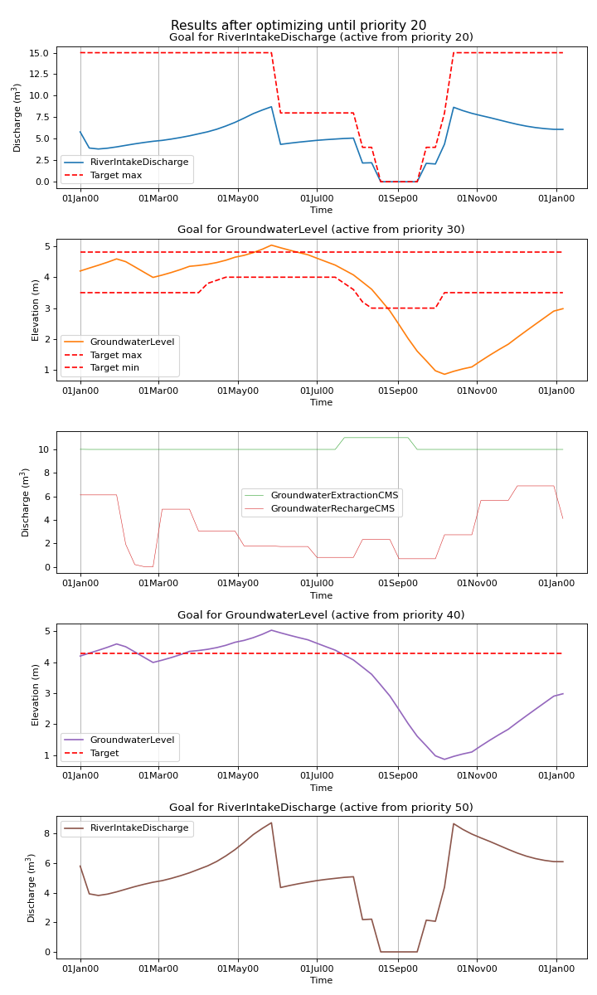
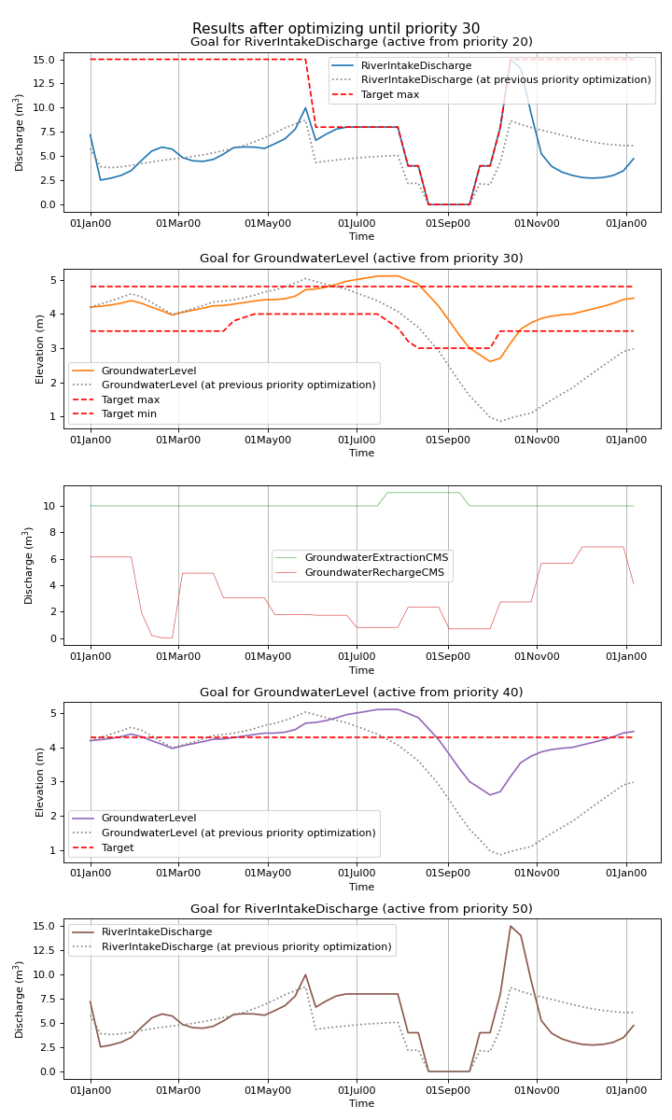
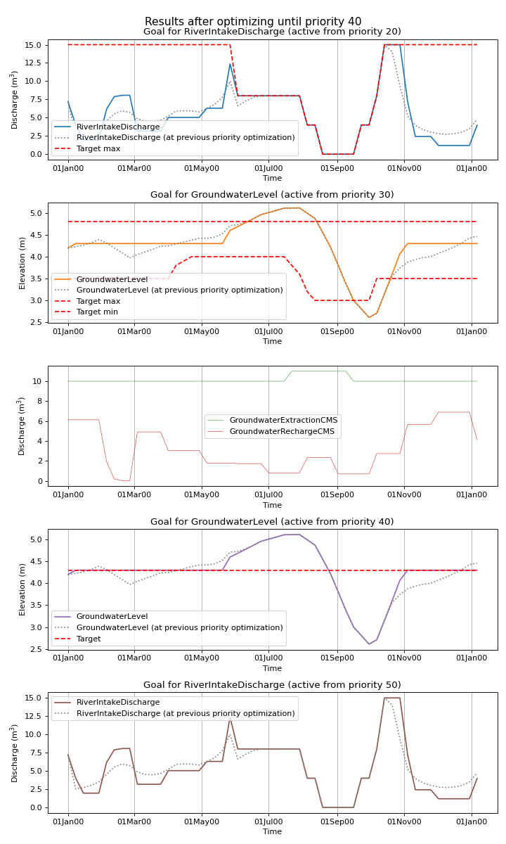
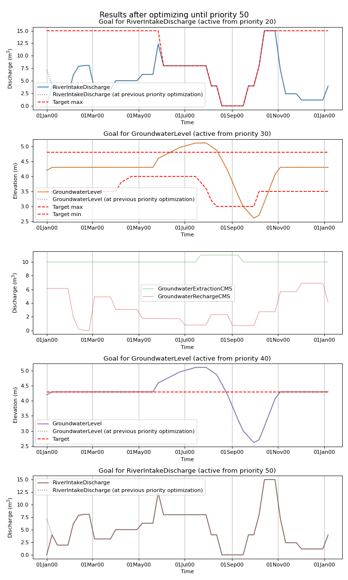
Goal programming for conflict resolution
Multiple optimizations in the sequence of prioirities
Achieved goals are maintained in consecutive optimization

Slide 9
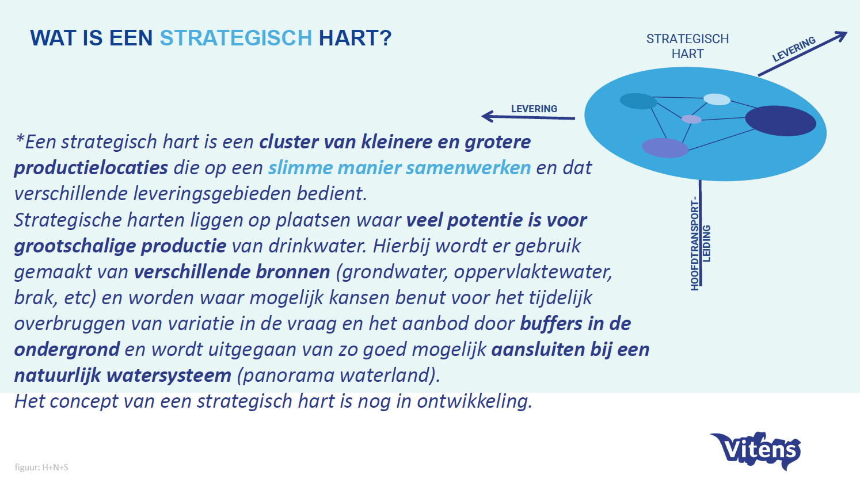
Strategic hearts
Bron: Igor Jellema (visie Vitens; in ontwikkeling)

Slide 10
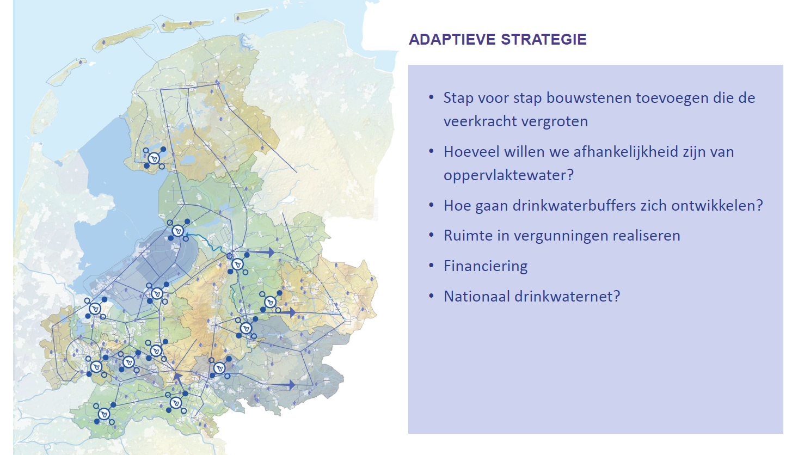
Strategic hearts
Bron: Igor Jellema (visie Vitens; in ontwikkeling)

